Slide 1
World War II The Home Front
American History
Chapter 17

Slide 2
Mobilizing the Home Front
Building National Morale
Japan’s Attack on Pearl Harbor Unified Americans in Favor of War
Franklin Roosevelt’s Four Freedoms:
Freedom of Speech and Expression
Freedom of Worship
Freedom from Want
Freedom from Fear

Slide 3
Mobilizing the Home Front
Calling All Volunteers
Government Created the Office of Civilian Defense (OCD)
Citizens Should Contribute One Hour a Day to the War Effort
“Victory Gardens”
People Used all Available Space
Produce 40% of all Vegetables Consumed During the War
Drives:
Paper, Scrap Metal, Fat, Aluminum, Tin, etc.
Provided Much of the Necessary Materials for War

Slide 4
Grow a Victory Garden

Slide 5
Grow a Victory Garden

Slide 6
Save Kitchen Fat

Slide 7
Scrap Drives

Slide 8
Pitch In and Help!

Slide 9
Mobilizing the Home Front
The Media Goes to War
Office of War Information
Official Voice of the Government’s War Efforts
Exercised Censorship over Media that Did Not Support the War Effort
Produced Propaganda Films to Gain Support for the War
Hollywood Films Included:
Bombing of Honolulu, Yellow Peril, My Four Years in Japan, V For Victory

Slide 10
The Media Goes to War

Slide 11
Mobilizing the Home Front
The Media Goes to War
Movies Stereotyped the Germans, Japanese and Italians
Comic Strip Characters Supported the War
Little Orphan Annie– Called for Scrap Metal Drives
Daddy Warbucks– Served in the Military
Superman– Supported the Red Cross & War Bonds
New Comic Strips Included:
G.I. Joe, War, and Don Winslow of the Navy
Patriotism was Expressed in Songs, Advertisements, Newspapers, and Magazines
der fuehrer's face 1942 disney

Slide 12
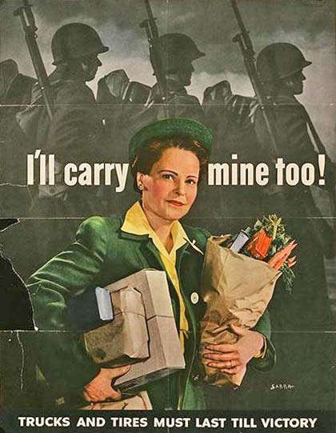
Mobilizing the Home Front
Advertisers Urged Americans to Conserve:
“Use it Up”
“Make it Last”
“Do Without”

Slide 13
Mobilizing the Home Front
Staging a Production Miracle
1941– 15% of the Nation’s Manufacturing Was Directed Toward the Military
January 1942– FDR Created the War Production Board (WPB)
WPB: “Exercise General Responsibility” over the Nation’s Economy
Factories Had To Be Converted From Civilian to Military Production
Aircraft, Tanks, Uniforms, Bombs, Munitions etc.

Slide 14
Mobilizing the Home Front
Staging a Production Miracle
Sec. of War– Henry Stimson Made Sure Industries Made Money From War Production
Henry Kaiser– Shipbuilder, Richmond, Ca.
Cut the Construction Time from 105 Days to 14
Kaiser Shipyard Used Women Workers to Construct Ships
Richmond, California Became a Wartime Boom Town

Slide 15
Mobilizing the Home Front

Slide 16
Richmond, Ca. Shipyard

Slide 17
Rosie The Riveter

Slide 18
Mobilizing the Home Front
Directing a Wartime Economy
Gross National Product (GNP)
Total Value of Good and Services Produced
$90.5 Billion in 1939
$211.9 Billion in 1945
War Created 17 Million New Jobs
Crop Prices Doubled
Demand For Few Consumer Goods Was High
Cost of Living Increased (Inflation)
To Control Inflation, FDR Froze Wages

Slide 19
Wartime Production

Slide 20
Mobilizing the Home Front
Controlling Wages and Prices
National War Labor Board (NWLB)
Created by FDR to Control Wages and Keep Track of Inflation
1942 NWLB Created a Formula to Allow Wages to Go Up at the Same Rate as the Cost of Living
1943– Inflation Continued, The NWLB Issued a “Hold the Line” Order on Hourly Wages
People Could Still Make More Money by Working Overtime

Slide 21
Mobilizing the Home Front
Controlling Wages and Prices
During the War Wage Rates Rose by 24%
Weekly Earning Rose by 70% (Overtime)
Office of Price Administration
Set a Ceiling on All Prices
The Consumer Price Index Showed that the Cost of Goods Rose at the Same Percentage as Wages between 1939 and 1945

Slide 22
Controlling Prices
Rationing During WW II

Slide 23
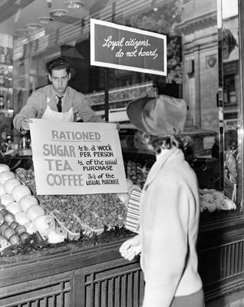
Mobilizing the Home Front
Reducing Demand Through Rationing
Rationing Provided a Fair Distribution of Scarce Consumer Goods
What Was Rationed?
Processed and Canned Foods
Meat
Gasoline
Rubber (Tires)
Dairy Products
Shoes
Many Other Consumer Goods

Slide 24
Mobilizing the Home Front
Reducing Demand Through Rationing
Every Person in a Household Received a Ration Book (Even Children)
Ration Stamps Were Worth Points
Products had Both a Price and a Point Value
Local War Ration Boards Established Each Families “Need”
A Doctor Received More Ration Stamps than other “Less Important” Occupations
People Turned in Their Stamps to Merchants
Merchants Turned In Stamps to Suppliers

Slide 25
Reducing Demand Through Rationing
A War Ration Book & the Kind of Products that Were Rationed
Food that Had the Potential to Shipped Overseas
An Example of the Stamps, and Their Point Values

Slide 26
Reducing Demand Through Rationing
Making the Point Value of Your Stamps “Add Up”
By Considering the Volume of the Product You Could Save Both Money and Ration Stamps

Slide 27
Reducing Demand Through Rationing
Your Bill Included Both the Price in Money, and the Ration Points Necessary
Fresh Produce That Could Not Be Shipped Overseas Was Not Rationed

Slide 28
Reducing Demand Through Rationing

Slide 29
Mobilizing the Home Front
Paying For a Costly War
World War II Cost Ten Times As Much as World War I
1941-1945 Government Spent $321 Billion
Taxes Covered about 40% of That Amount
Before The War Many Americans Did Not Pay Federal Income Tax
1943– Congress Approved the Federal Tax Withholding System (Payroll Deductions)
Still In Use Today

Slide 30
Paying for a Costly War
60% of the War Was Paid For With Borrowed Money
War Bonds Were Sold to Help Pay for the War
Buying Bonds Was the Patriotic Thing to Do

Slide 31
Buy War Bonds

Slide 32
Paying for a Costly War
Children Were Encouraged to Buy War Stamps and Bonds
Bonds Were Paid Back With Interest
Americans Save $129 Billion For Post-War Purchases

Slide 33
Paying for a Costly War

Slide 34
Mobilizing the Home Front
Trying to Uphold a No-Strike Pledge
Labor Unions Made a “Non-Binding Pledge” Not to Strike During the War
The NWLB Was to Oversee Wages and Working Conditions to Keep Workers On the Job

Slide 35
Mobilizing the Home Front
Trying to Uphold a No-Strike Pledge
1943– 3 Million Workers Went out on Strike
Most Serious Strike was the Coal Miners led by UMW President John L. Lewis
FDR Took over the Mines– Urged to Jail Striking Workers
“A Jailed Miner Mines No More Coal Than a Striking Miner”
For the Most Part, The No-Strike Pledge Was Honored
John L. Lewis

Slide 36
Mobilizing the Home Front
Recruiting New Workers
15 Million Americans Served in the Military
Workers Were Needed to Fill those Jobs
High Unemployment of the Depression Ended
1940-45 6 Million Women Joined the Workforce
Women Worked in Defense Industries
Shipbuilding, Aircraft, Assembly Lines, etc.
Women Worked for Lower Wages
When the War Ended, So Did Women’s Jobs

Slide 37
Women in the Workforce

Slide 38
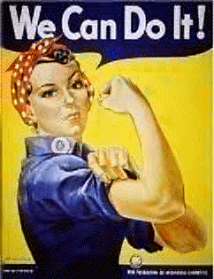
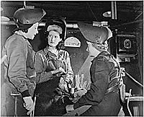
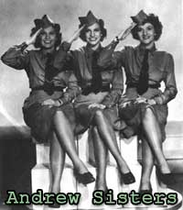
Women in the Workforce
The Andrews Sisters

Slide 39
The War and Social Change
Americans on the Move
The “Great Migration”
The Greatest Short-Term Migration of People in American History
Rural to Urban, East to West
West Coast Gained the Greatest Share of the Increased Population (California, Washington, Arizona, & Oregon)
During the War, The Number of Farm Workers Fell, but Farm Production Increased

Slide 40
The Great Migration

Slide 41
The War and Social Change
Boomtowns Emerge
Serious Problems were Created by Population Shifts
Inadequate Housing, Poor Medical Facilities, Improper Sanitation, Overcrowded Schools, & No Daycare Facilities
People Lived in Trailers and Tents
9 Million Migrant Workers Needed Housing

Slide 42
Meeting the Demand for Housing

Slide 43
Boomtowns
Boomtowns Included:
Willow Run, Michigan– Ford Bomber Factory
Pascagoula, Mississippi-- Shipyard
San Diego, California– Aircraft Factory & Naval Base

Slide 44
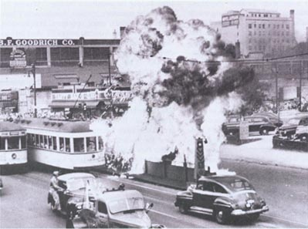
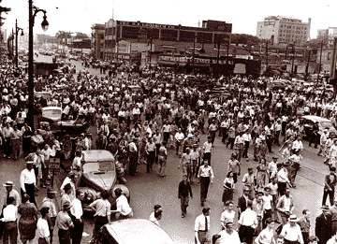
The War and Social Change
Social Stresses Multiply
Racial Tensions Explode
Detroit Riots– June 1943– 36 Hours of Violence Between Whites and African Americans
25 African Americans and 9 Whites Killed, 700 injured
$2 Million in Property Damage
6,000 Soldiers Moved into Detroit to Restore Order
Other Riots Occurred in Harlem, New York & on Military Bases

Slide 45
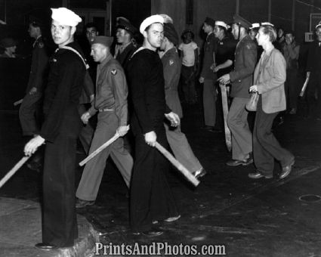
The War and Social Change
The Zoot Suit Riots (June 1943)
Large Baggy Suits Worn By Young Hispanic Men
Many Resented the Amount of Wool That Was Required to Make the Zoot Suits
Zoot-Suitors Were Accused of Robbing Sailors in L.A.
Sailors Beat Up People Wearing Zoot Suits
Police Arrested Zoot-Suitors
Zoot Suits Were Outlawed in Los Angeles
Zoot Suits

Slide 46
The War and Social Change
Wartime Family Stresses
By 1944– Almost 3 Million Teenaged Workers
Child Labor Laws were Ignored During the War
Many Teens Dropped Out of School, and Went to Work
Juvenile Delinquency Increased Dramatically
“Youth in Crisis”– Wartime Documentary Addressing the Problem of Juvenile Delinquency
Even Young Children Contributed to the War Effort
Scrap Drives, Stamp Purchases, etc.

Slide 47
The War and Social Change
The End of the New Deal
Military Priorities Replaced Social Reforms
Some New Deal Programs Were Here To Stay
Social Security, the TVA, Unemployment Insurance
Wartime Priorities Demanded Change
Longer Work Week (40 to 48 Hours)
Stop Rural Electrification– Copper Was a War Metal
Suspend Child Labor Laws
Antitrust Laws Were Suspended
New Deal Agencies were Phased Out (CCC, WPA, etc)
Government Stayed Involved in the Economy
Deficit Spending to Stimulate the Economy
FDR Won a 4th Term in 1944

Slide 48
The War and Civil Rights
The Civil Rights Movement Grows
Some Drew Parallels Between Racism in The United States and in Germany
Racism– Belief that Race Determines Human Capacities, (Some Races are Superior to Others)
Racism Provided the Basis for Segregation
Racial Inferiority Was Proven False by the 1940s
African Americans Responded by Seeking Equality
Double V Campaign– Victory Overseas and At Home
Racial Equality Should Help Win the War

Slide 49
The War and Civil Rights

Slide 50
The War and Civil Rights
Civil Rights Gains
Jim Crow Laws in the South & Slums in the North Kept African Americans Segregated
1941– Asa Philip Randolph Led the Movement for African American Equality
Randolph Is Known as the Father of the Civil Rights Movement
He Was Called “The Most Dangerous Black Man in America”

Slide 51
The War and Civil Rights
Randolph Organized the “Brotherhood of Sleeping Car Porters” in 1925
Organized the March on Washington Movement (MOWM)
Spoke For African Americans, Puerto Ricans, Mexicans, Poor Whites and Native Americans

Slide 52
The War and Civil Rights
Roosevelt and Randolph Compromise
FDR Did Not Want a “March on Washington”
Randolph Made 3 Demands on the President:
End Defense Contracts for Discriminatory Employers
Roosevelt would not hurt the war effort
End Job Segregation in Federal Agencies
Roosevelt established an agency to investigate job segregation
Desegregation of the Armed Forces
FDR Felt that an integrated armed forces might cause problems in the military

Slide 53
The War and Civil Rights
Executive Order 8802– Government Agencies, Job Training Programs, and Defense Contractors End Discrimination (June 25, 1941)
The Fair Employment Practices Committee (FEPC) Investigated Violations of this Order

Slide 54
The War and Civil Rights
Other Victories
Congress of Racial Equality (CORE)
Organized in 1942 To Continue the Struggle For Civil Rights
CORE Organized Mass Resistance to Discrimination
CORE Used “Civil Disobedience” to Challenge Laws
“Civil Disobedience”– Openly Violate Unjust Laws and Challenge them in the Courts

Slide 55
The War and Civil Rights
Membership in the NAACP Grew to 450,000 by 1946
Smith v. Allwright 1944, The Supreme Court Ruled that African Americans Could Not be Denied the Right to Vote in Primary Elections in the South

Slide 56
The War and Civil Rights
The Fair Employment Practices Committee Fights Discrimination
The FEPC Was Largely Ineffective
It Had No Power to Enforce Its Actions
Could Act Only Upon Formal Complaints (Few Were Filed)
Government Contracts Could be Canceled for Discrimination, But That Hurt the War Effort
Public Opinion Was Against the FEPC
FEPC Acted Upon Discrimination, Not Segregation
Only Resolved One-Third of the 8,000 Complaints Filed
FEPC Formally Dissolved by Congress in 1945

Slide 57
The War and Civil Rights
Internment of Japanese Americans
There Was Little Backlash Against Americans of German or Italian Decent During WW II
The Japanese Were the Exception

Slide 58
The War and Civil Rights
Relocation of Japanese Americans
1942 The Government Decided that all Japanese Would be Relocated to Internment Camps
There Were More Than 100,000 Japanese Living In the United States
Issei– Foreign Born Japanese (One Third of the Japanese)
Nisei– Japanese Born in the United States (Two-Thirds)

Slide 59
The War and Civil Rights
Internment Camps Were Located In California, Arizona, Utah, Colorado, Wyoming, Idaho, and Arkansas

Slide 60
The War and Civil Rights
Executive Order 9066 on February 19, 1942 Called for the Relocation of the Japanese
Easily Singled out, and Lacking Economic Influence Japanese Were Relocated

Slide 61
The War and Civil Rights

Slide 62
The War and Civil Rights
Japanese Internees Were Allowed Few Possessions
Most Were Forced to Liquidate Their Assets
Property Not Sold Was Often Stolen or Vandalized
The Loss Estimates are About $500 Million
The Relocation Was Justified On Military Grounds
The Japanese Would Sabotage American War Facilities
The Japanese Would Become the Targets of Americans
The Japanese Race was Seen as an Enemy Race
Camps Were Not Located In the Most Desirable Spots
Extreme Heat and Cold
Dust

Slide 63
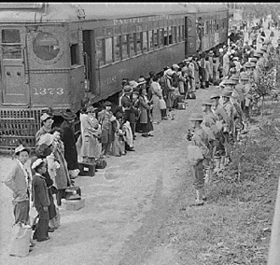
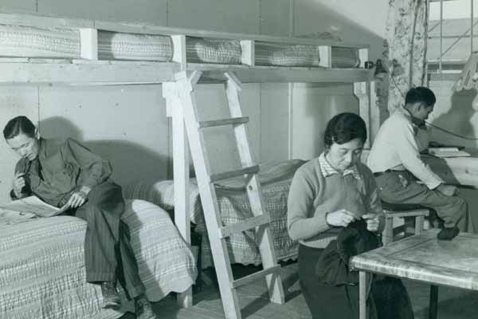
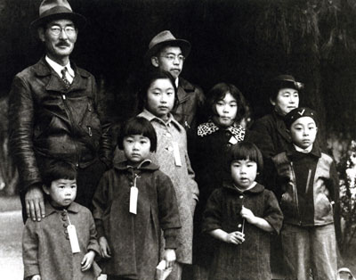
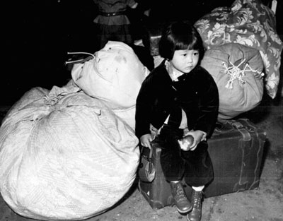
Japanese Internment Camps

Slide 64
The War and Civil Rights
Life in the Internment Camps
Entire Families Lived in a Single Room
The Japanese Made the Best of the Situation
Formed Schools, Civil Organization, Scouts, Athletic Associations, Newspapers, Gardened, Landscaped, and Looked Forward to the War’s End
Many Contributed to the War Effort by Working in Food Production

Slide 65
The War and Civil Rights
Judicial Rulings Support Relocation
Hirabayashi v. United States 1943– Court Ruled that a Curfew Order Affecting only Japanese Did Not Violate their Constitutional Rights
Korematsu v. United States 1944– Court Supported the Executive Order 9066 Because the Court Could Not Second Guess the Military
Once Loyalty Had Been Established the Japanese Must Be Released
Civil Rights Gains By African Americans Were Offset by Losses Felt by Japanese Americans

